Slide 1
AWT Concepts
CS 5100
Lecture 09

Slide 2
Visual Components
Always derived from Component
Component is abstract, can’t be instantiated
Components control their size by overriding getPreferred(Maximum)(Minimum)Size
Components can be disabled. Usually they have a different appearance.
Cursors are not components - components are responsible for drawing their own cursors

Slide 3
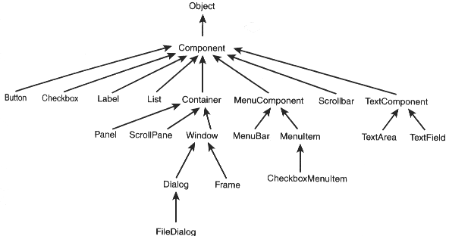

Slide 4
Component Properties
Background, foreground, colorModel
locale, font, fontMetrics
Bounds and size
Relative and screen locations
Cursor
Enabled state, visible state
Name
Sizes - preferred, maximum, minimum
Graphics, toolkit

Slide 5
Component Methods
There are get (is) and set methods for these
getAlignmentX, getAlignmentY
getX, getY
getWidth, get Height
isShowing
contains
toString, print, printAll
paint, update, repaint, invalidate
requestFocus, transferFocus

Slide 6
Rendering Components
Heavyweight paint themselves
Lightweight painted by nearest hw ancestor
Repaint called by system or application - finds Graphics, schedules update
Update paints to background, calls paint
All rendering should be done in, or called by, paint
Some repaint methods repaint only a rectangle, or have a time limit

Slide 7
Containers
The Container class is abstract
  Delegates layout to a manager
  Maintains a list of children
Repaint repaints all children in the list order
Nested containers are used to create logical and visual meaning for the user, and to specialize layout managers to portions of the container

Slide 8
Container Methods
add - at end, at position, by name, with constraints
getComponents returns an array of size getComponentCount
getComponent - component at list position
findComponent and getComponentAt
remove, removeAll
isAncestorOf
validate

Slide 9
Hints
Super replaces automatic execution of the default base class constructor with execution of some other base class constructor.
declaration versus construction
  garbage collection
  container list
  scope
Sloppy code

Slide 10
Other AWT Components
Graphics provides drawing capabilities
Fonts and fontMetrics
Color and colorModels
Data transfer
Applets

